Slide 1



Please help us!
Thank our Sponsors:

Slide 2

Data Ingestion

Slide 3
Please Be Courteous!

Slide 4
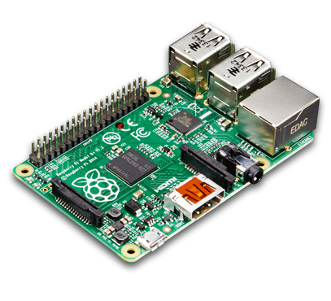




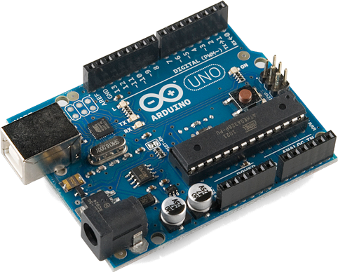



About Me… Kevin Whitson
15+ years software development
10+ years database administration
2.5 years working in Hadoop
LinkedIn: www.kevinwhitson.com
Blog: www.idledeveloper.com

Slide 5

About You…
Who uses Hadoop daily?
Who uses Hadoop weekly?
Who uses Hadoop monthly?
Anyone never use it at all?

Slide 6





About free Hadoop VMs
Hortonworks
VMware, VirtualBox, Sandbox in the cloud
Cloudera
VMware, VirtualBox, Docker, KVM

Slide 7
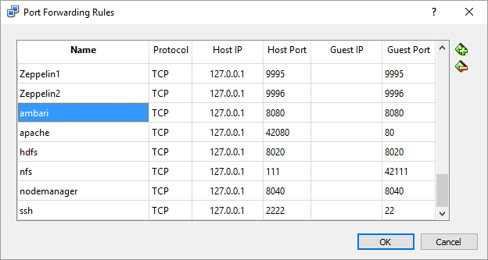
About The Hortonworks VirtualBox VM
There are several port forwarding rules for 127.0.0.1
Network > Advanced > Port Forwarding
Set up a shared folder between the host and the VM

Slide 8


About This Session…
GitHub
https://github.com/whitsonk/TulsaTechfest2016
Load some CSV data
View Data via Hive, File Browser, & Terminal
Basic Sqoop Migration
Common Problems with both approaches

Slide 9
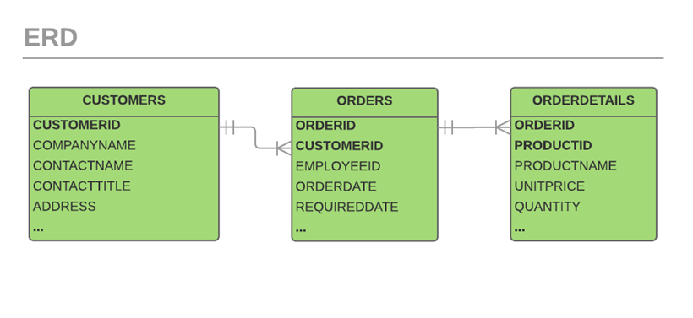
About The Data… (all on GitHub)
Sqlite3 Northwind database (DB & SQL)
PostgreSQL Dump
CSV files

Slide 10
Demo
demo
Ambari File Browser: http://localhost:8080
Ambari Views (Hive / Beeswax)
Hive Shell

Slide 11
Please Complete An Evaluation Form Your input is important!
You can access Evaluation Forms at:
http://TulsaTechFest.com
Fill them out!
You can win additional prizes!
Like a $50 Best Buy Gift Card!!
Winner drawn – Midnight, Sun Aug 7th!

Slide 12
Please help us!
Thank our Sponsors:

